Slide 1


Slide 2
Population
σ²_{Between}
____________
= 1
σ²_{Within}
Sample
MS_{Between}
__________
MS_{Within}

Slide 3
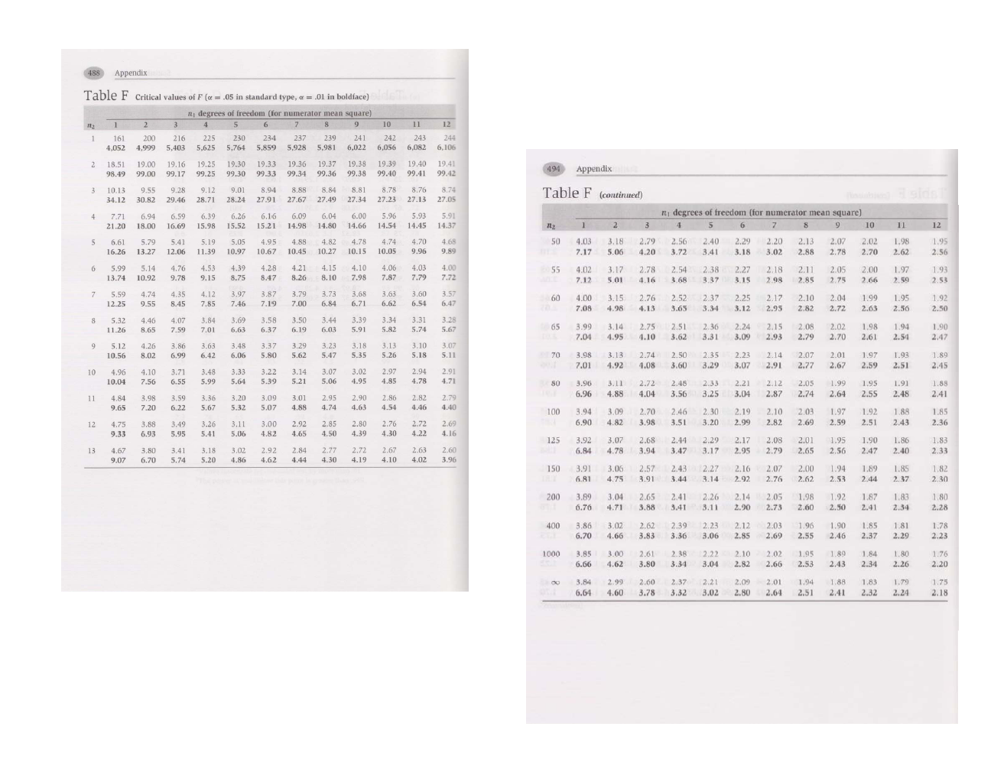

Slide 4
Fisher’s Protected t-test
_
_
X_{i} - X_{j}
t =
MS_{W} ( 1/N_{i} + 1/N_{j})
Where df = N - k

Slide 5
df_{B} (F - 1)
Est ω =
df_{B} F + df_{W}
Est ω bears the same relationship to F that r_{pb} bears to t.

